Slide 1


Kanishk K.R
Lalith Kishore
Aniket Dash
Saksam
Harsh V

Slide 2
What is Raw
FM?
RawFM is the ultimate portable music companion.
- Built-in SIM support for streaming
- FM Radio access
- Bluetooth connectivity
- Stylish earbuds included
- Compact display for info & control

Slide 3
Key Features
🎧 SIM-enabled streaming
📻 FM Radio access
🔊 Bluetooth earbuds
📱 Compact digital display
🔋 Long battery life

Slide 4
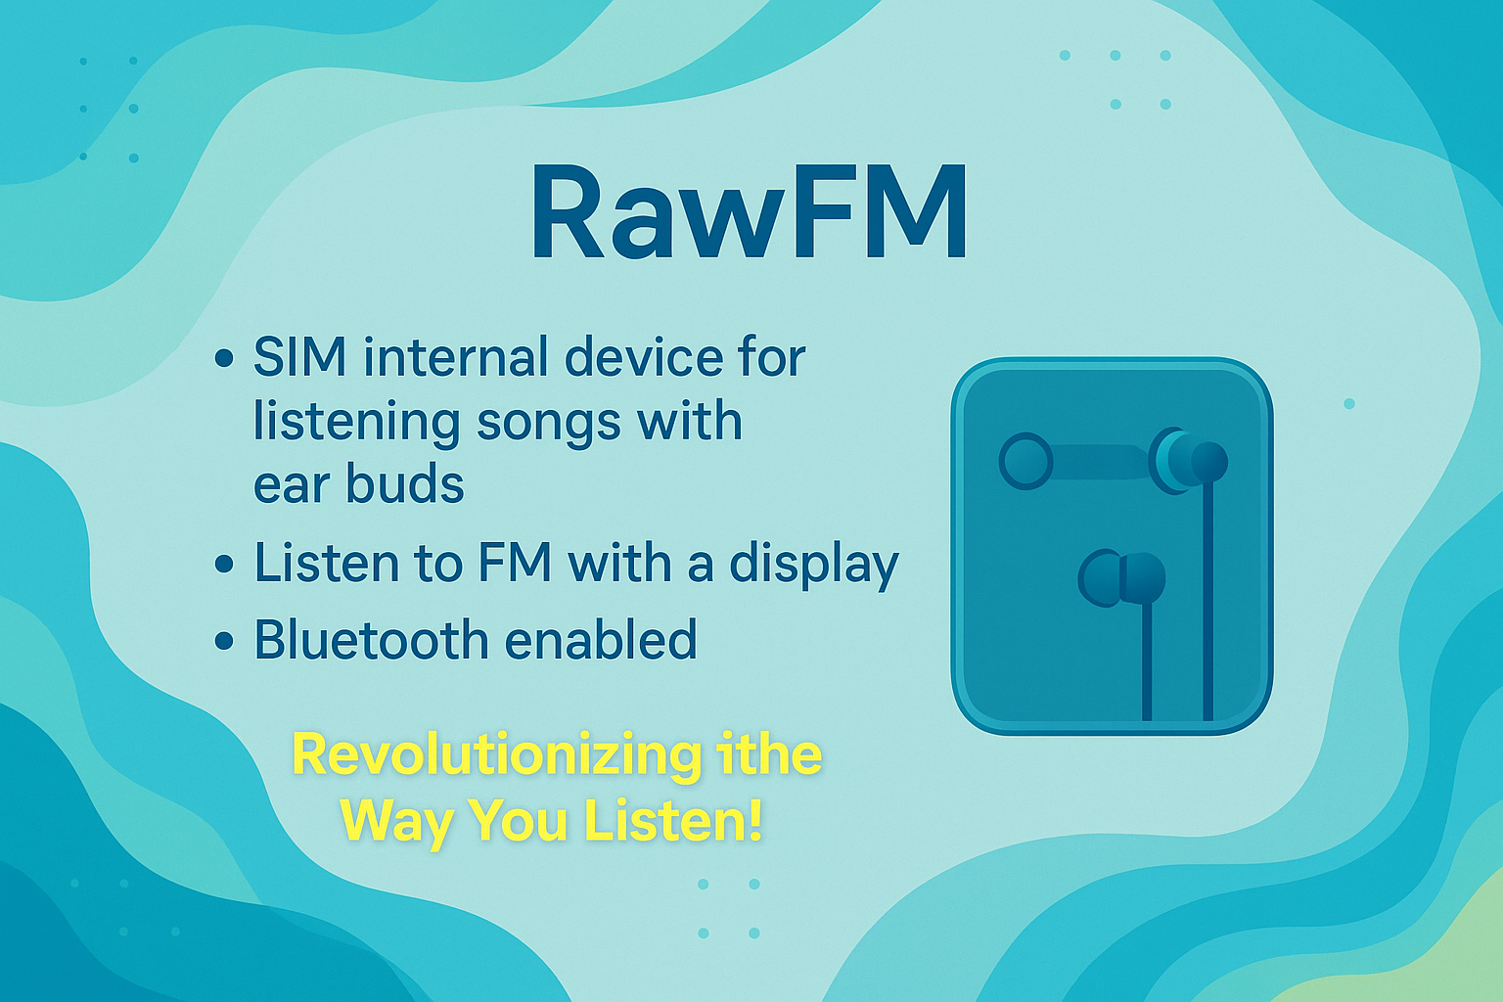

Slide 5
- No WiFi? No Problem!
- Works without a phone
- Lightweight & pocket-friendly
- Great for school, travel, and daily use
Why Choose RawFM?

Slide 6

🎉 Special Offer
for Students
💥 20% OFF for first 100 students
🎁 Free pouch with every RawFM

Slide 7
Thank You!
Feel the Beat, Live the Moment!
— RawFM

